Slide 1


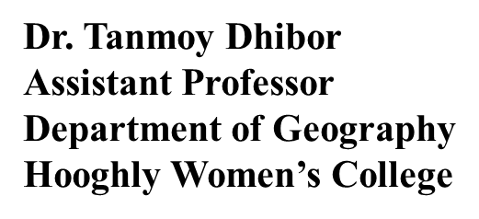

CC1 - GEOTECTONICS AND GEOMORPHOLOGY
Unit 1: Geotectonics
2. Earth’s interior with special reference to seismology.

Slide 2
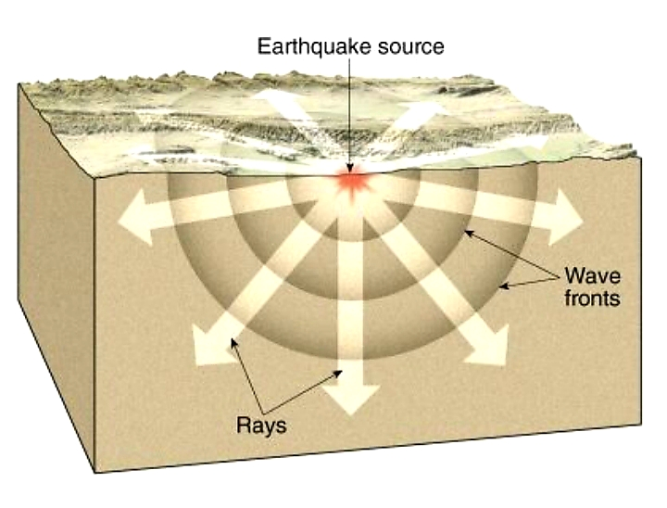
Seismic Waves:
There are two categories of earthquake waves. Body waves can travel deep into the Earth; Surface waves can only travel very near the surface of the Earth. There are two kinds of body waves, and two kinds of surface waves.
Body Waves:
P Waves : These are also called compressional or longitudinal waves. Material is compressed and stretched in the horizontal direction, from left to right, and the wave (disturbance) also travels in the horizontal direction . P waves travel faster than any other type of wave. They can travel through fluid or solid materials.
S Waves :These are also called shear waves. S comes from secondary wave . Material is sheared,so that an imaginary square drawn on the side of the block becomes diamond shaped . The material vibrates up and down (or side to side, in and out of the screen, if the hammer had struck the side of the block instead of the top) but the wave (disturbance) travels in the horizontal direction from left to right. S waves travel more slowly than P waves. They can only travel through solid materials.
SEISMOLOGY

Slide 3
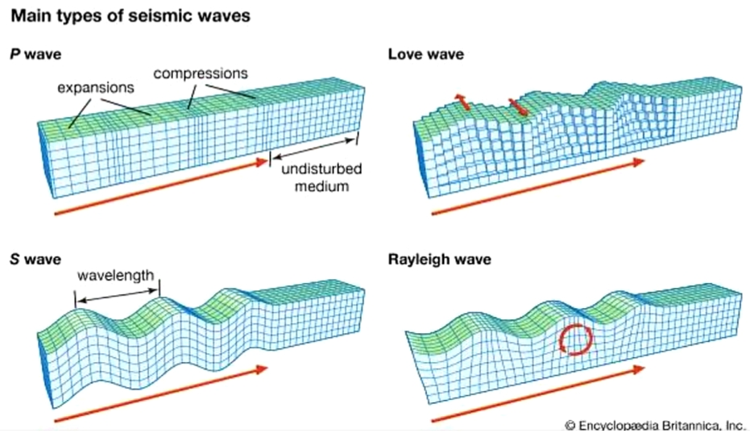
Surface Waves :
Love Wave :
They are largest at
the surface. Love waves are
dispersive.
Rayleigh Wave :
Rayleigh waves are also dispersive
and the amplitude generally decrease
with depth of the earth.
el

Slide 4
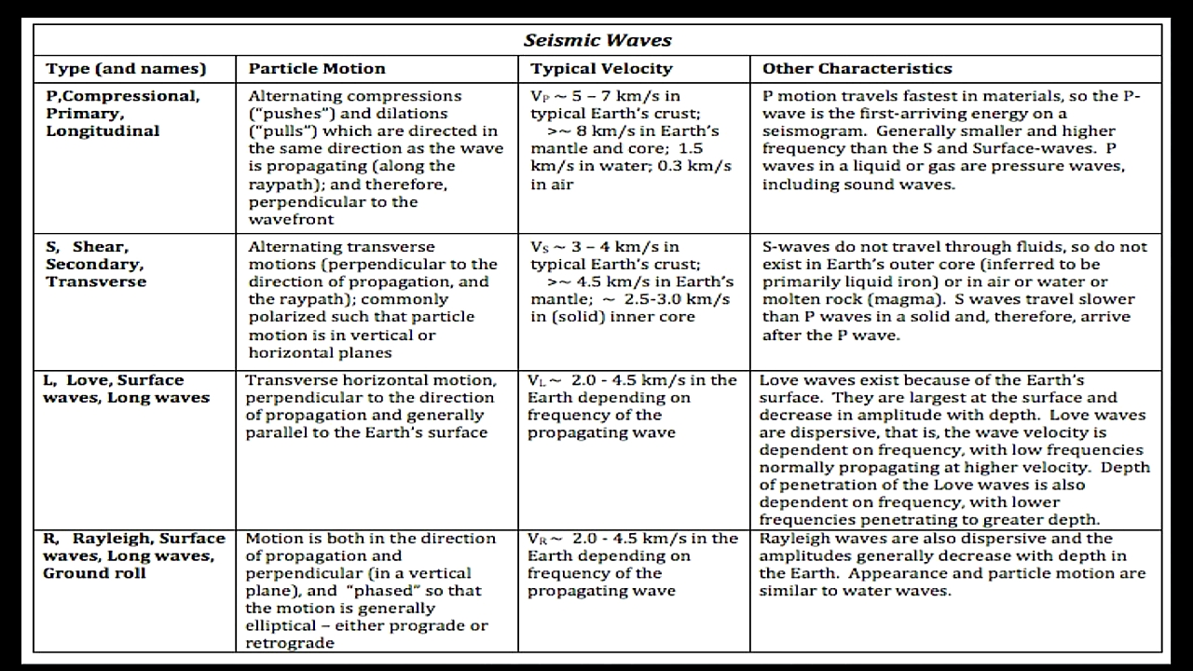

Slide 5
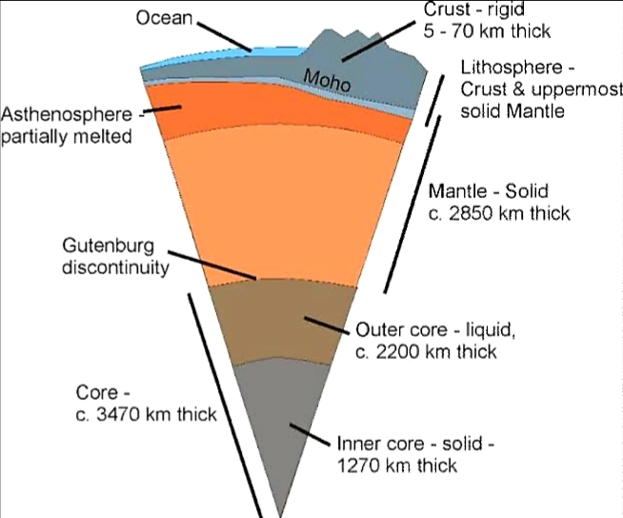
EVIDENCE FOR INTERIOR EARTH AND COMPOSITION
• The structure of Earth's deep interior cannot be studied directly. But geologists use seismic (earthquake) waves to determine the depths of layers of molten and semi-molten material within Earth. Because different types of earthquake waves behave differently when they encounter material in different states (for example, molten, semi-molten, solid), seismic stations established around Earth detect and record the strengths of the different types of waves and the directions from which they came. Geologists use these records to establish the structure of Earth's interior.

Slide 6
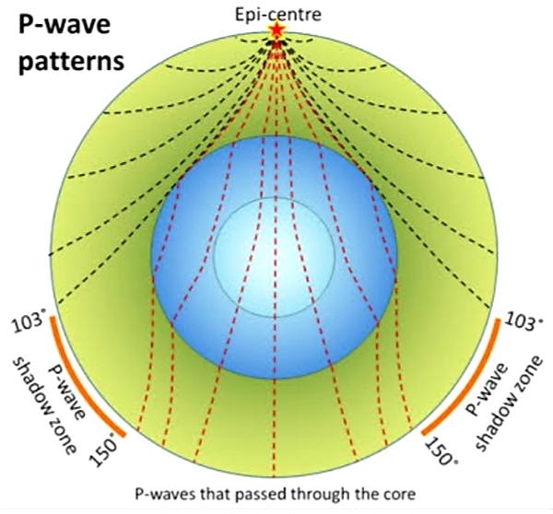
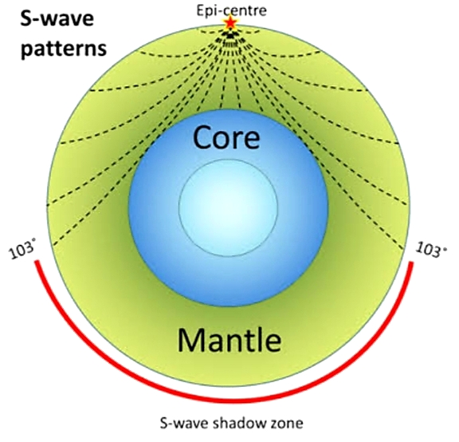
EARTHQUAKE SEISMOLOGY AND THE INTERIOR OF THE EARTH
The main points about using earthquakes waves to determine the internal structure of the Earth are summarized here : By measuring travel times of earthquake waves to seismograph stations, we can determine velocity structure of Earth. By making graphs of travel time versus distance between earthquakes and seismograph stations, we find velocity generally increases gradually w/ depth in Earth, due to increasing pressure and rigidity of the rocks however, there are abrupt velocity changes at certain depths, indicating layering. The 4 major layers in the Earth, from outside in, are the crust, mantle, outer core, and inner core. The crust is very thin, averaging about 30 km thick in the continents and 5 km thick in the oceans The mantle is 2900 km thick (almost halfway to the center of the Earth. It is made of dark, dense, ultramafic rock (peridotite). The outer core is 2300 km thick and is made of a mixture liquid iron (90%) and nickel (10%) The inner core is at the center of the Earth and has a 1200 km radius; it's made of solid iron (90%) and nickel (10%).

Slide 7
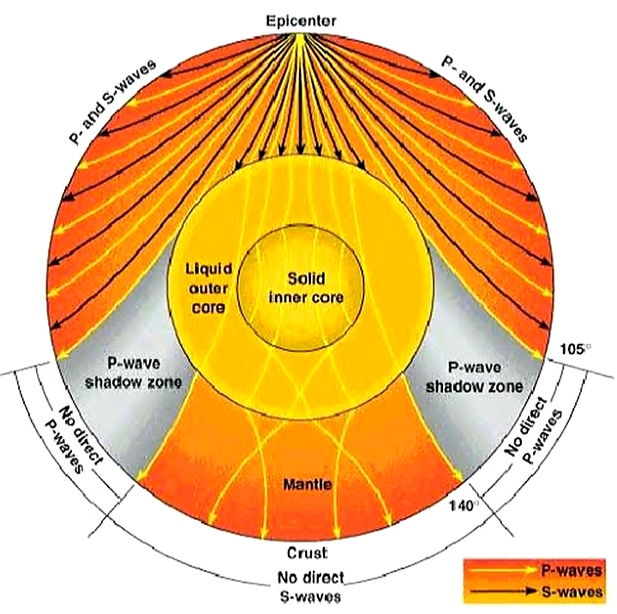
SHADOW ZONE:
• The shadow zone is the area of the earth from angular distances of 104 to 140 degrees from a given earthquake that does not receive any direct P waves. The shadow zone results from S waves being stopped entirely by the liquid core and P waves being bent (refracted) by the liquid core.

Slide 8
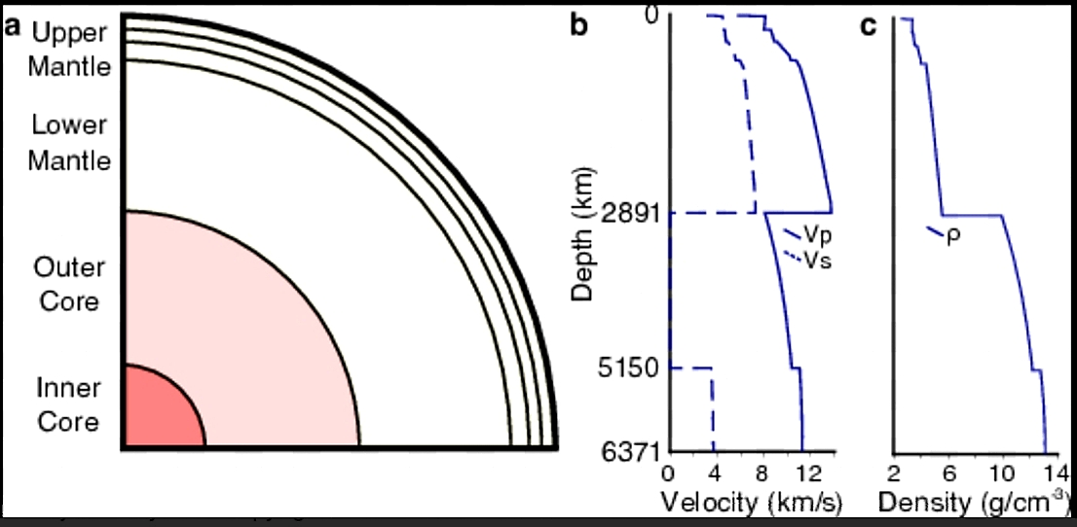
LOW VELOCITY ZONE:
• Low-velocity zone (LVZ)The zone within the upper mantle beneath the oceans within which seismic P waves are slowed and S-waves are slowed and partially absorbed. The top of the zone is some 40–60 km deep near the oceanic spreading ridges, and this depth increases to 120–160 km beneath the older oceanic crust. The bottom of the zone is poorly defined, but in the region of 250–300 km in depth. Beneath the continents, a restricted low-velocity zone occurs beneath crust areas subjected to orogenesis during the last 600 million years or so, but is not found beneath cratonic areas. It is attributed to the presence of a 0.1% fluid phase and commonly ascribed to the partial melting of mantle rocks at these depths. It is often considered coincident with the asthenosphere, but probably this is valid only for oceanic areas.

Slide 9
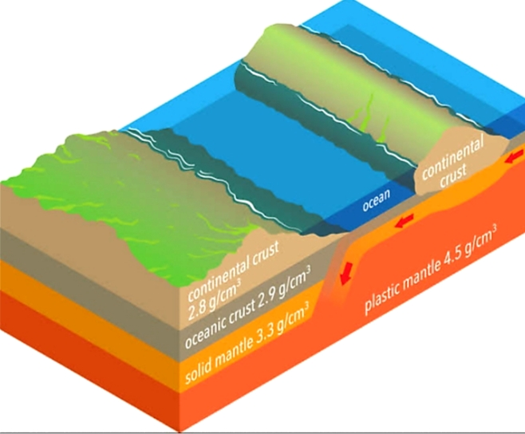
THE INTERIOR OF THE EARTH:
CRUST :
It is the outermost solid part of the earth, normally about 8-40 kms thick. It is brittle in nature. Nearly 1% of the earth’s volume and 0.5% of earth’s mass are made of the crust. The thickness of the crust under the oceanic and continental areas are different. Oceanic crust is thinner (about 5kms) as compared to the continental crust (about 30kms). Major constituent elements of crust are Silica (Si) and Aluminium (Al) and thus, it is often termed asSIAL (Sometimes SIAL is used to refer Lithosphere, which is the region comprising the crust and uppermost solid mantle, also). The mean density of the materials in the crust is 3g/cm3. The discontinuity between the hydrosphere and crust is termed as the Conrad Discontinuity.
MANTLE

Slide 10
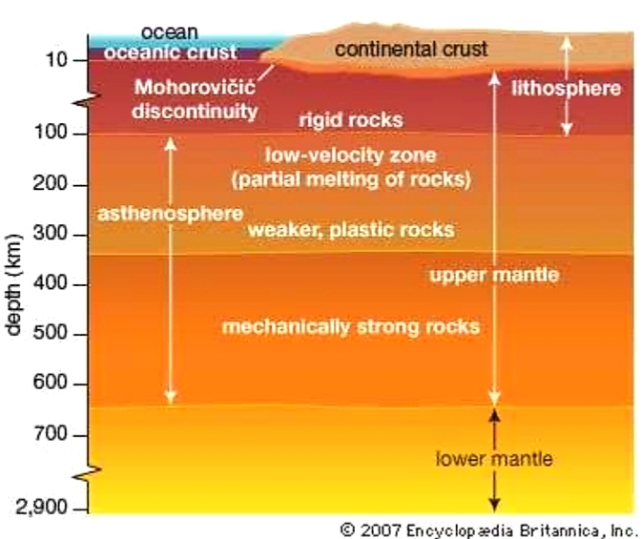
MANTLE:
• The portion of the interior beyond the crust is called as the mantle.
• The discontinuity between the crust and mantle is called as the Mohorovich Discontinuity or Moho discontinuity.
• The mantle is about 2900kms in thickness.
• Nearly 84% of the earth’s volume and 67% of the earth’s mass is occupied by the mantle.
• The major constituent elements of the mantle are Silicon and Magnesium and hence it is also termed as SIMA.
• The density of the layer is higher than the crust and varies from 3.3 – 5.4g/cm3. • The uppermost solid part of the mantle and the entire crust constitute the Lithosphere.
• Theasthenosphere(in between 80-200km) is a highly viscous, mechanically weak and ductile, deforming region of the upper mantle which lies just below the lithosphere.
• The asthenosphere is the main source of magma and it is the layer over which the lithospheric plates/ continental plates move (plate tectonics). The discontinuity between the upper mantle and the lower mantle is known as Repetti Discontinuity.
• The portion of the mantle which is just below the lithosphere and asthenosphere, but above the core is called as Mesosphere.

Slide 11
CORE :
• It is the innermost layer surrounding the earth’s centre.
• Thecore is separated from the mantle by Guttenberg’s Discontinuity.
• It is composed mainly of iron (Fe) and nickel (Ni) and hence it is also called as NIFE.
• The core constitutes nearly 15% of earth’s volume and 32.5% of earth’s mass.
• The core is the densest layer of the earth with its density ranges between 9.5-14.5g/cm3.
• The Core consists of two sub-layers: the inner core and the outer core.
• The inner core is in solid state and the outer core is in the liquid state (or semi-liquid).
• The discontinuity between the upper core and the lower core is called as Lehmann Discontinuity.
• Barysphereis sometimes used to refer the core of the earth or sometimes the whole interior.

Slide 12
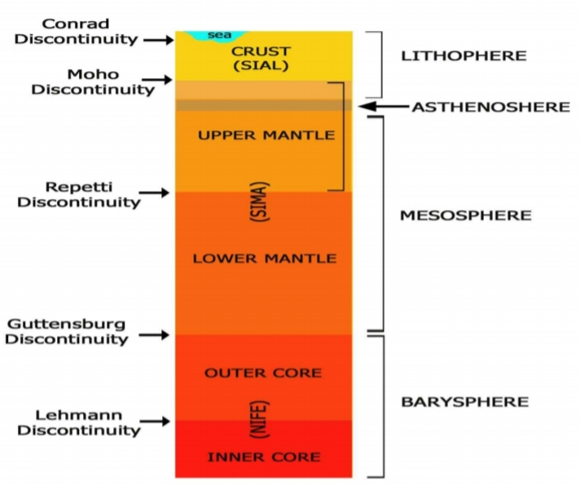
DISCONTINUITIES

Slide 13
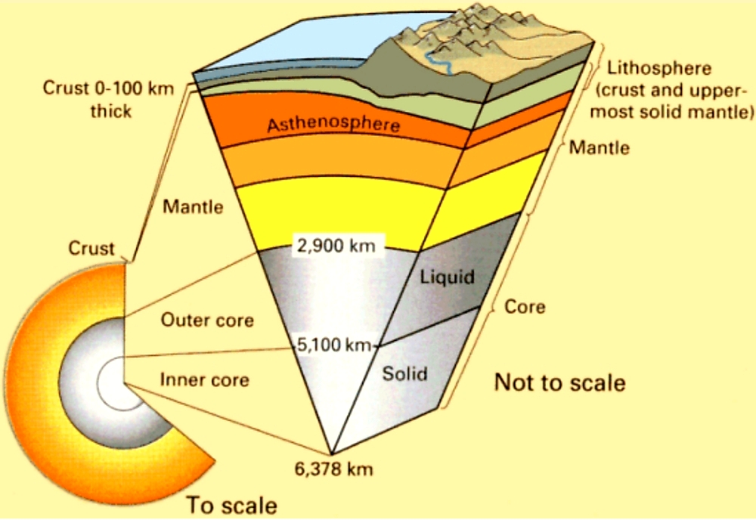
EARTH’S INTERIOR STRUCTURE

